Slide 1
UNDERSTAND SERVICE LIFECYCLE IN AZURE

Slide 2
Agenda
Public and private preview features
How to access preview features
General availability
Monitoring feature updates

Slide 3
Public and private preview features
Microsoft will often offer new services and features to customers as preview offerings. While the Microsoft official term is preview, you will often see people refer to these services and features as being a beta offering.
Services and features that are in preview do not offer an SLA, and they are not meant to be used in production applications. Preview features are also usually not offered in all Azure regions. Microsoft will provide documentation on which regions are available for a specific preview.
In private preview, the service or feature is made available to a small set of customers for testing. Access to a private preview is sometimes by invitation from the engineering team developing the service or feature.
Once a service or feature meets a specific bar set by the engineering team, it will transition to public preview.

Slide 4
Agenda
Public and private preview features
How to access preview features
General availability
Monitoring feature updates

Slide 5
How to access preview features
Customers participating in a private preview are sometimes given a secret link to the Azure portal that enables the service or feature. When the customer uses that link, Microsoft can use their Azure subscription ID to determine if they have registered and are approved for the private preview. If they aren’t, the feature or service won’t be available, even if they use the secret link.
In other situations, the Azure portal experience hasn’t been developed for a private preview feature or service. In those cases, customers are given command-line instructions for using the service or feature.
Once a service or feature reaches public preview, it is made available to all customers in the regions where it’s available, and no registration is required to use the service or feature. A preview badge will be displayed in the Azure portal so that users will know that the service or feature is a preview offering.

Slide 6
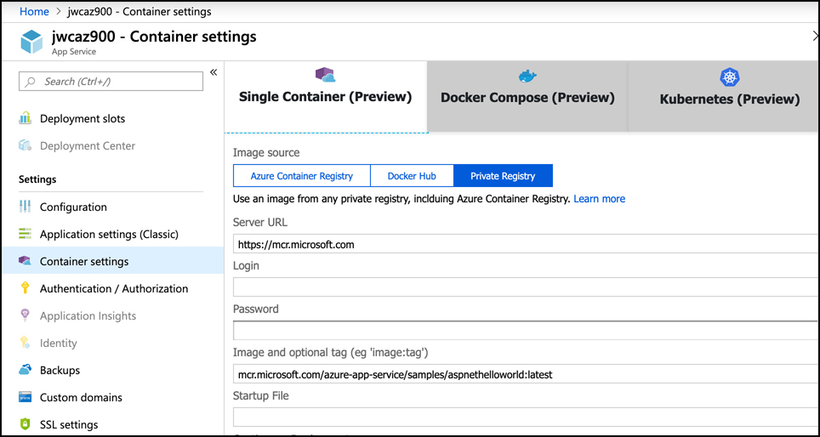
How to access preview features

Slide 7
Agenda
Public and private preview features
How to access preview features
General availability
Monitoring feature updates

Slide 8
General availability
Once a preview service or feature reaches a quality and availability bar suitable to the engineering team, they will declare general availability or GA. At this point, the service or feature is fully supported.
Once a service or feature reaches GA, it falls under the SLA Microsoft provides. If it’s a new service, a new SLA will be published on the SLA web page. For new features of existing services, once GA is reached, the feature will inherit the SLA of the service it’s a feature of.

Slide 9
Agenda
Public and private preview features
How to access preview features
General availability
Monitoring feature updates

Slide 10
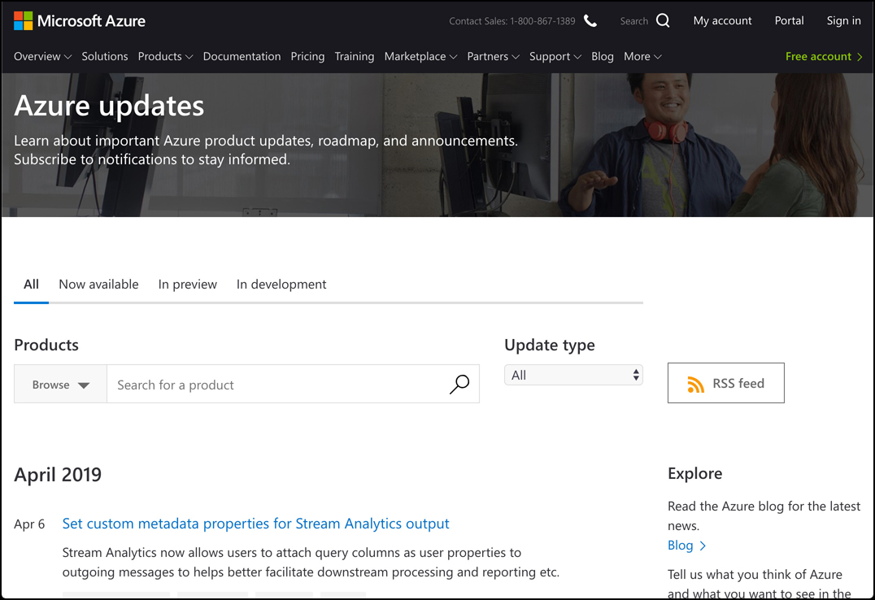
Monitoring feature updates
Microsoft will usually post announcements of new features and services on the Azure blog at: https://azure.microsoft.com/en-us/blog/topics/announcements. However, a more reliable source of information on feature and service updates is the Azure Updates web page available at: https://azure.microsoft.com/en-us/updates.

Slide 11
Monitoring feature updates
To show only updates on a particular stage of product lifecycle, use the tabs at the top of the list.
The Now Available tab shows all updates about GA services and features.
The In Preview tab will show all services and features in public or private preview.
The In Development tab will show information related to features or services that are currently in development but not yet available to customers.
To show updates only for the products you’re interested in, you can search for a product by entering it in the search box. You can also click Browse and select one or more products from the list

